Slide 1
California Real Estate: New Avenues for Investment
Objective:
Guide the client's expansion plan by analyzing key data points and trends in the real estate market in CA

Slide 2
Key Factors
Zip code diversity
Growth potential
Affordability (average home value)
Investment potential (Median vs. Average Home Values)
Supply and demands dynamic (homes for sale per 1000 people)
Population growth

Slide 3
San Francisco-Oakland-Hayward
High Home Value Metro Consideration: Population Growth and Investment Diversity
High Projected Population Growth: The metro has the second-highest projected population growth from 2010-2020, with a growth of 878,242 people. A growing population often indicates increased demand for housing.
Higher Average than Median Home Values: San Francisco-Oakland-Hayward has a significant difference in average home values compared to median home values in March 2020, with an average difference of $126,402.
High Number of Zip Codes: The metro has 168 zip codes with higher average home values than median values, indicating diverse investment opportunities within the region.
Historical Growth: It also falls among the top 15 metros with the highest growth percentage (40%) from 2015 to 2020, suggesting a trend of increasing demand.

Slide 4
Sacramento-Roseville-Arden-Arcade
Mid Home Value Metro Consideration: Population Growth and Investment Diversity
High population growth (2010- projected 2020): The Sacramento--Roseville--Arden-Arcade metro area shows the highest population growth from 2010-2020, indicating a trend of increasing demand for housing and real estate investment opportunities.
Diverse investment option: The metro area encompasses 120 zip codes, offering a diverse range of investment opportunities across different neighborhoods and property types.
Affordability: While not the most affordable market on the list, the metro area offers a mix of affordability and growth potential, making it an attractive choice for investors seeking balanced opportunities.
Home for sale: The data suggests competitive market with 2 homes for sale per 1000 people, which create more negotiation power for sellers.

Slide 5
Low Home Value Metro Consideration: Affordability and Growth
Fresno: With reasonable home values and a projected population growth of 176k in the past 10 years, Fresno offers a combination of affordability and growth potential. Fresno encompasses 56 zip codes, offering a diverse range of investment opportunities.
Modesto: Modesto presents similar characteristics to Fresno, with moderate home values, a projected population growth from 91,101 from 2010 - 2020, and 60% growth in home value since 2015. This metro area could provide investment opportunities for those seeking affordability without sacrificing growth potential.
Chico: Chico offers a mix of affordability and growth potential. With a projected population growth of 35,853, 56% growth in home value since 2015, and lower home values, it can be an attractive option for investors prioritizing affordability.

Slide 6
Data

Slide 7
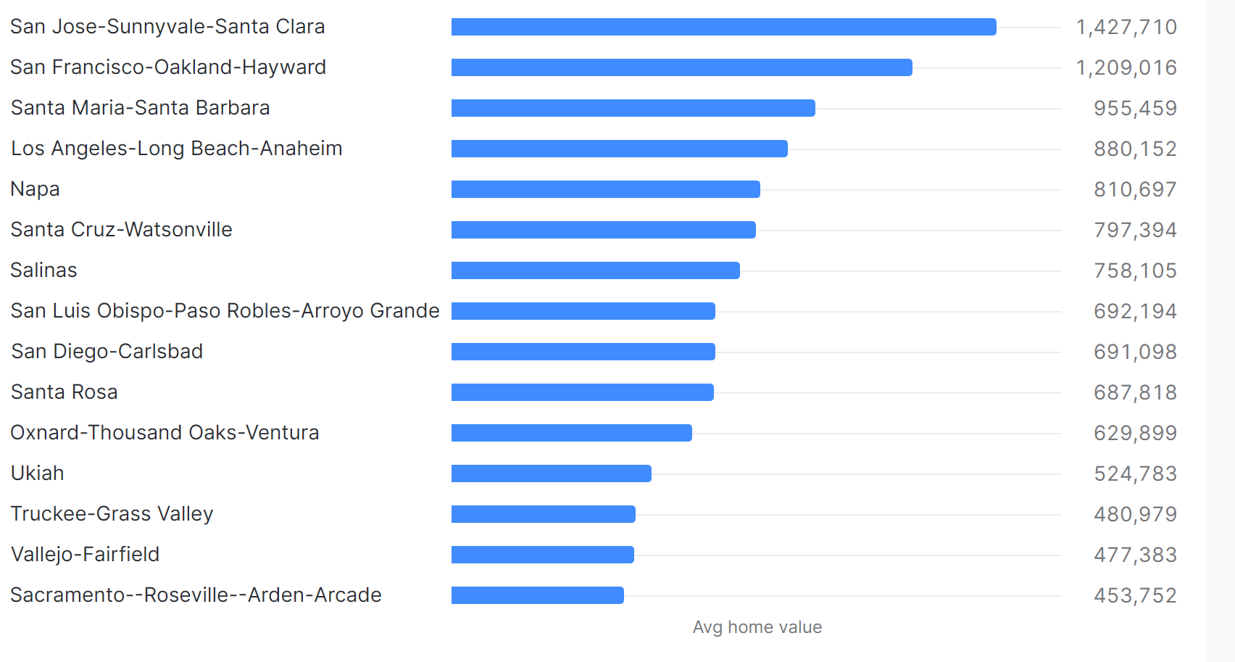
Top 15 Expensive Metros (2020)

Slide 8
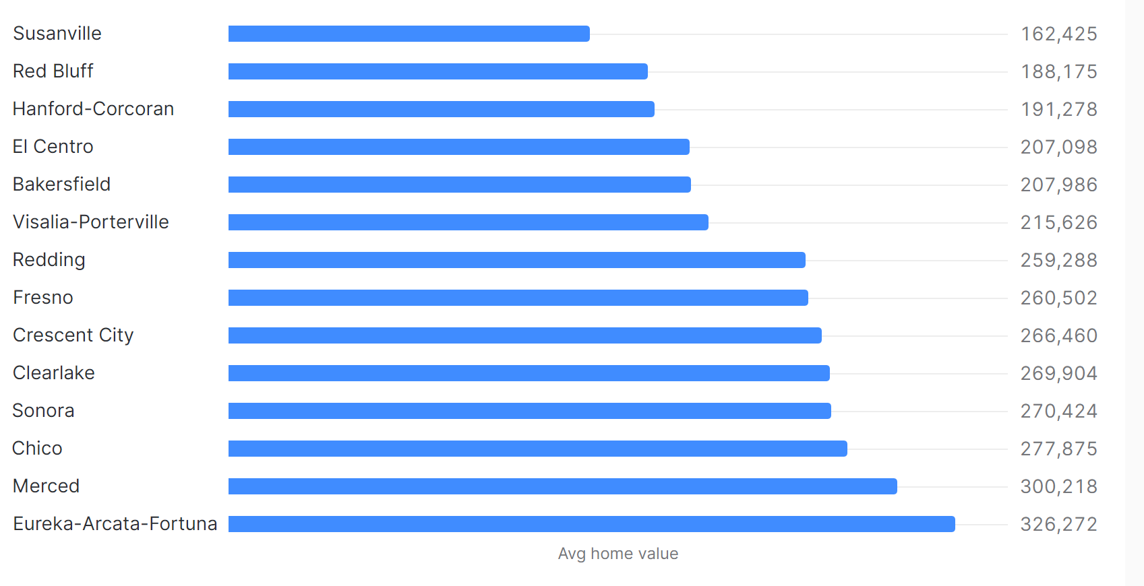
Top 15 Affordable Metros (2020)

Slide 9
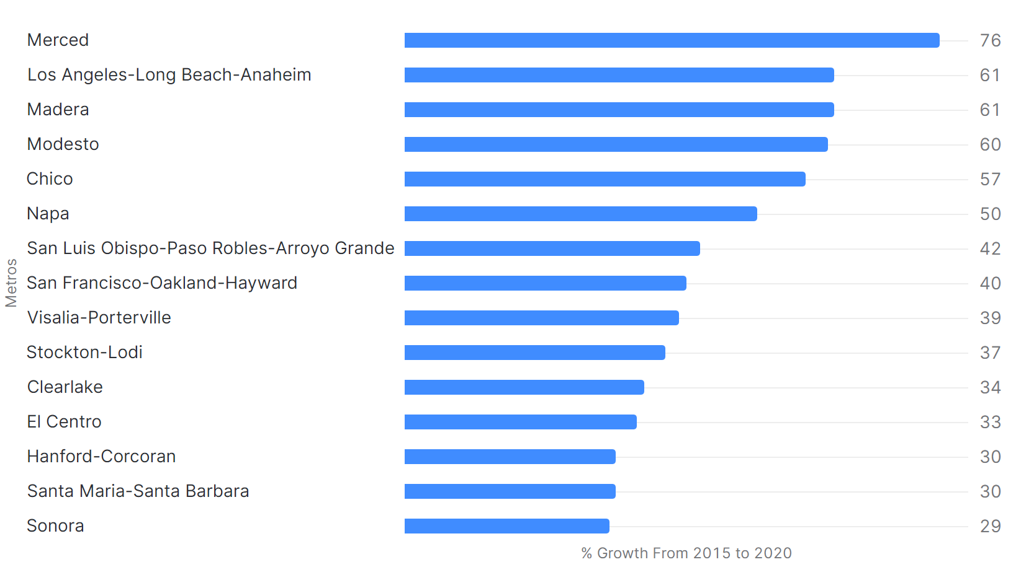
Top 15 Fastest Growing Metros (2015-2020)

Slide 10
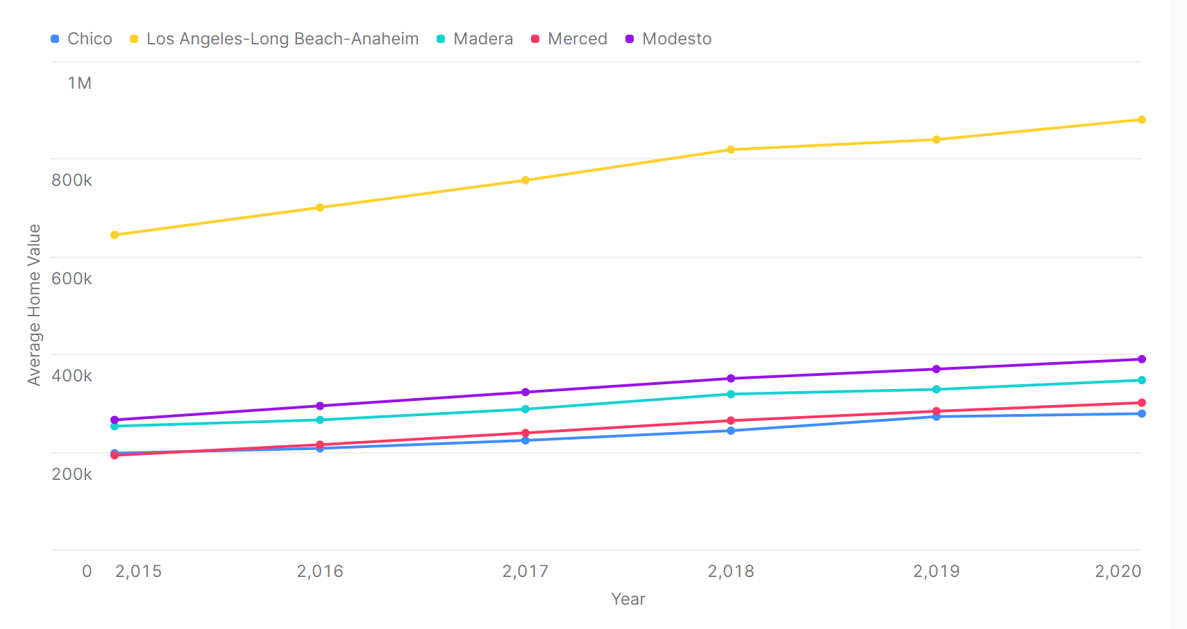
Average Home Value of The Top 5 Fastest Growing Metros

Slide 11
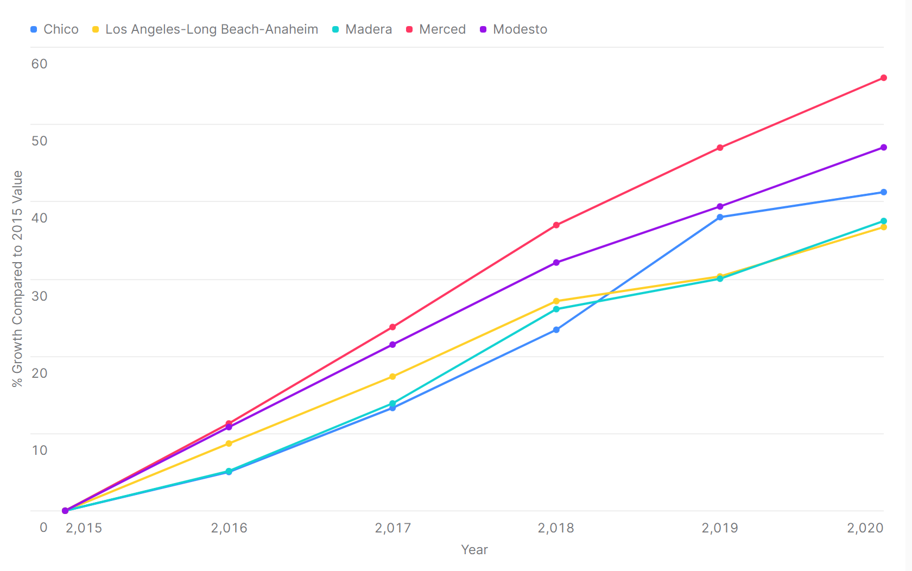
% Growth (2015 to Year) of Top 5 Fastest Growing Metros

Slide 12
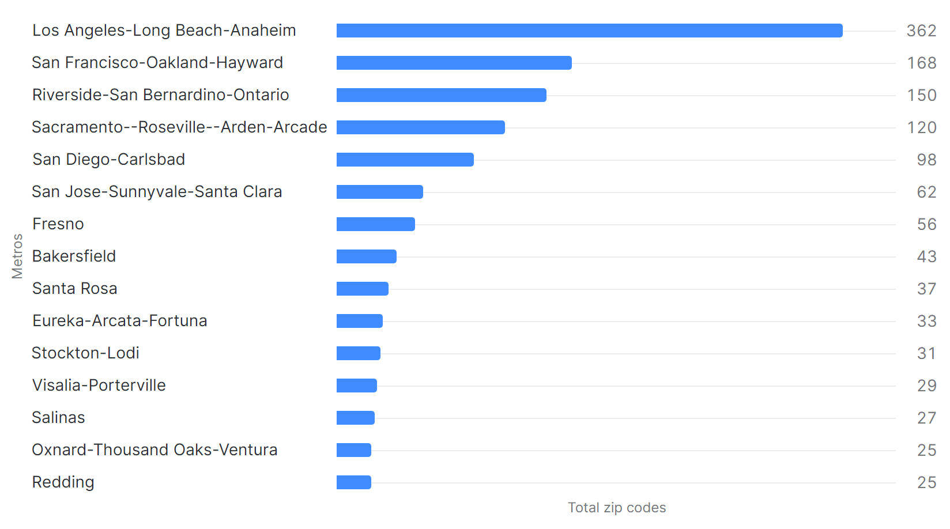
Top 15 metros with the most zip codes

Slide 13
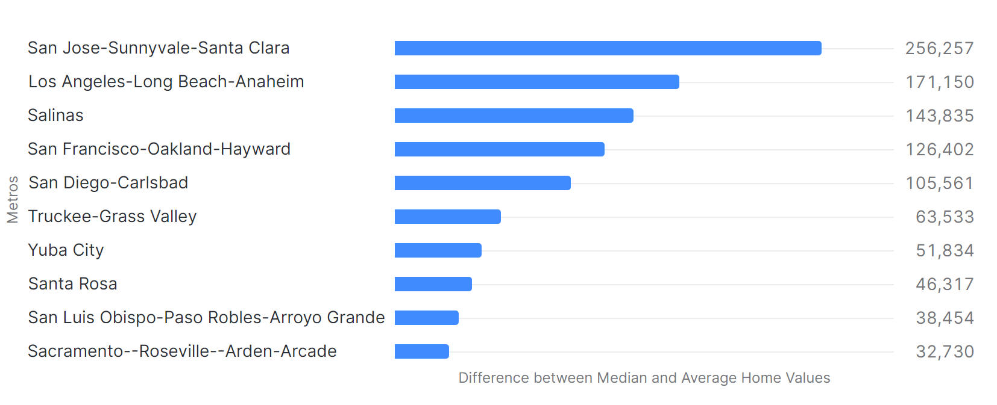
Metros with Higher Avg. than Median (Mar 2020)

Slide 14
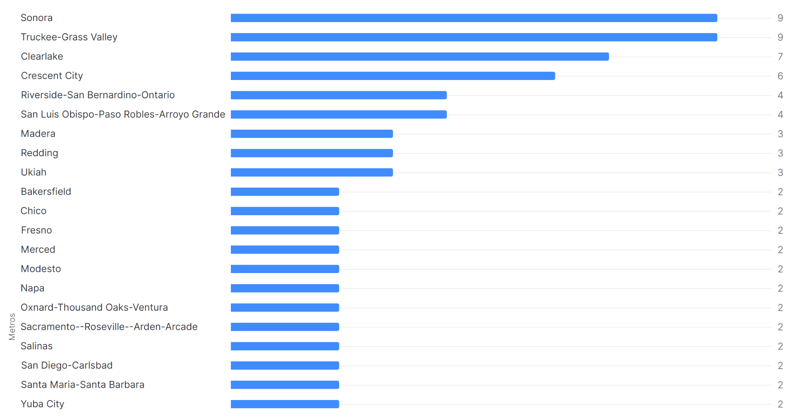
Number of Homes for Sale per 1000 People

Slide 15
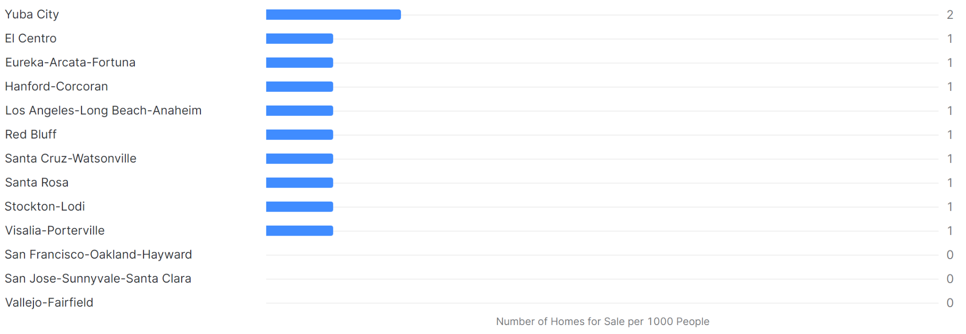
Number of Homes for Sale per 1000 People (cont.)

Slide 16
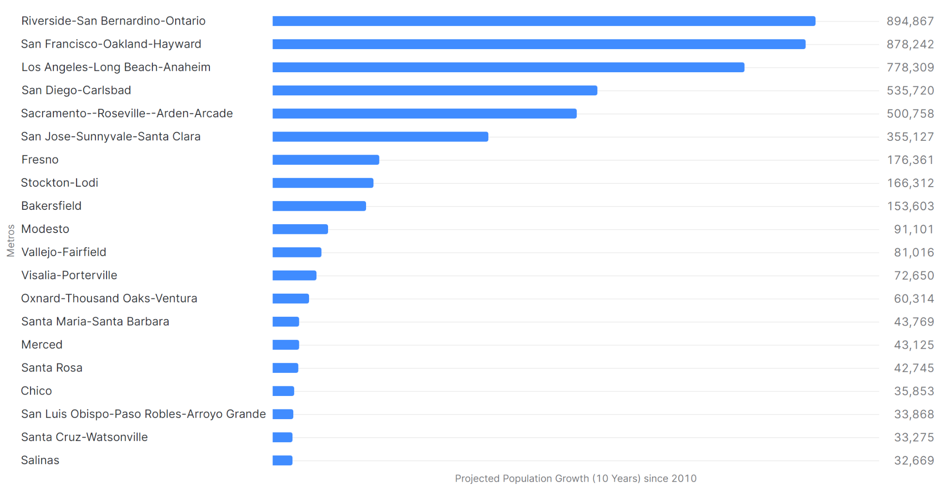
Top Metro with Highest Projected Population Growth (10 Years)

Slide 17
Other Factors to Consider
Additional demographic such as age, race, gender, family size and income.
Economic factors such as interest rate, job growth and unemployment rates.

